Slide 1
MATHEMATICS
Measurement of central tendency

Slide 2
Measurement of central tendency
This help you find the middle, or the average, of a data set. The 3 most common measures of central tendency are the mode, median, and mean.
The central tendency is stated as the statistical measures that represents the single value of the entire distribution or a dataset.
The central tendency of the dataset can be found out using the three important measures namely mean, median, mode.

Slide 3
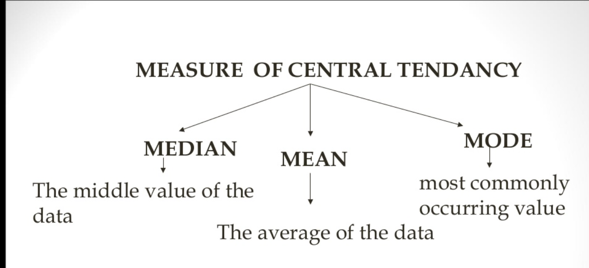

Slide 4
MEAN,MODE,MEDIAN
Median: the middle number in an ordered data set.
Mean: the sum of all values divided by the total number of values.
Mode: the most frequent value.
The mean, median, mode are the techniques that are often used in machine learning to solve the domain problem on the specific datasets.
Speed = [96,86,87,88,111,,86,103,87,94,78,77,85,86]
What is the Average, Middle, or the most common speed value.
mean/ Average = 89.77
Median = 87
Mode = 86.

Slide 5
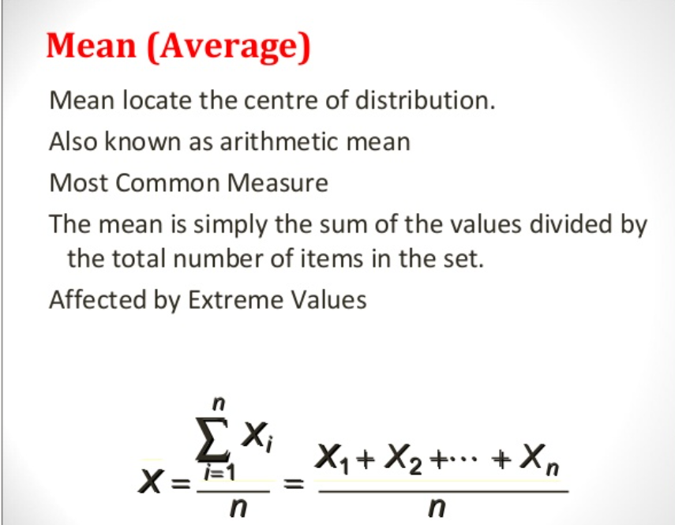

Slide 6
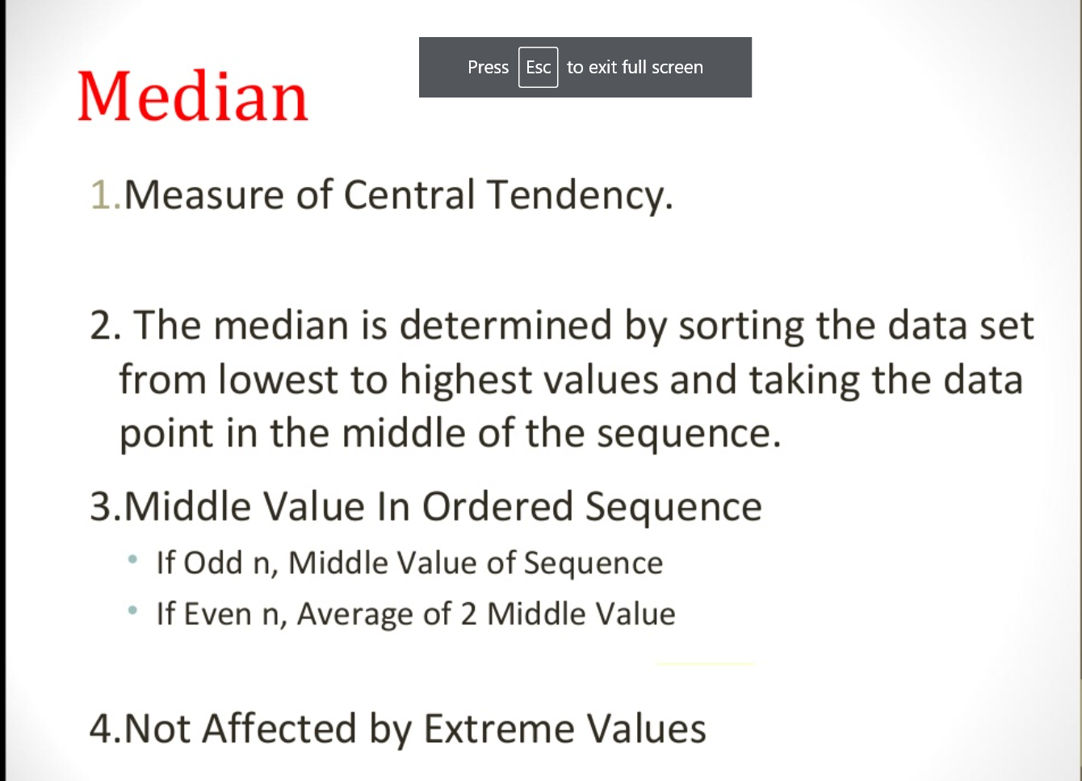

Slide 7
MODE:
Mode
The mode is the most frequently occurring value in the data set. It’s possible to have no mode, one mode, or more than one mode.
To find the mode, sort your data set numerically or categorically and select the response that occurs most frequently.

Slide 8
Example on central tendency:
Sample height values: x = [1,2,3,4,5]
Average/mean = 15/5 = 3
X = [1,2,3,4,5,100]
Median: 3 + 4 /2 = 7/2 = 3.5
Mean/Average = 115/6 = 19.16
The value of mean is not around the values in the dataset.
Median = 3 + 4/2 = 7/2 = 3.5
The value is nearly around the values of the dataset.

Slide 9
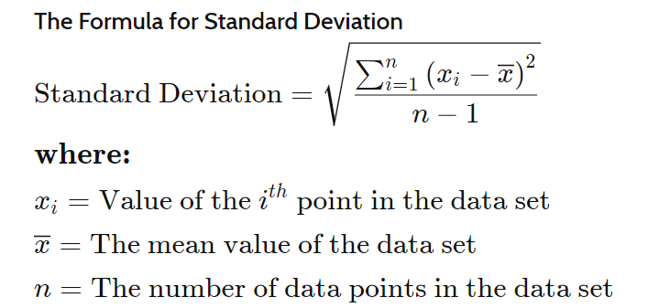
What is a Standard Deviation:
A standard deviation is a statistic that measures the dispersion of a dataset relative to its mean. The standard deviation is calculated as the square root of variance by determining each data point's deviation relative to the mean. If the data points are further from the mean, there is a higher deviation within the data set; thus, the more spread out the data, the higher the standard deviation.

Slide 10
STANDARD DEVIATION EXAMPLES:
Step 1: Find the mean.
Step 2: For each data point, find the square of its distance to the mean.
Step 3: Sum the values from Step 2.
Step 4: Divide by the number of data points.
Step 5: Take the square root.
Dataset x = [3,12,9,4,2]
Calculate Standard deviation.
Mean = 6
after mean the list is as [9 + 36 + 9 + 4 + 16] = 74/5
Variance = 14.8
Sd = (14.8)^2 = 3.847
Sd = 3.847

Slide 11
What is a variance:
The term variance refers to a statistical measurement of the spread between numbers in a data set. More specifically, variance measures how far each number in the set is from the mean and thus from every other number in the set. Variance is often depicted by this symbol: σ². It is used by both analysts and traders to determine volatility and market security. The square root of the variance is the standard deviation (σ), which helps determine the consistency of an investment’s returns over a period of time.

Slide 12
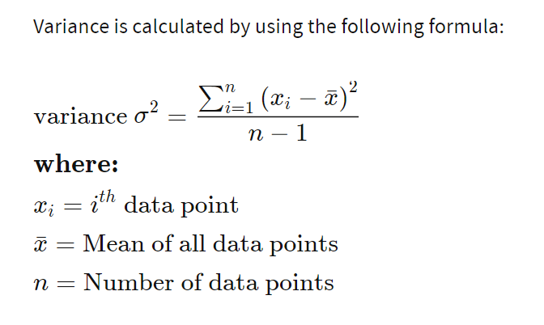
Variance:

Slide 13
Mean, Median, Mode & Standard deviation:
a.) 7,11,16, 14, 11, 13, 19, 13,13
Mean = 13
Median = 11
Mode = 13.
After subtracting mean from elements the list is as follows
[36 + 4 + 9 + 1 + 4 + 36] = 90/6 = 15
Variance = 15
Sd = 3.8729.

Slide 14
Mean, Median, Mode & Standard deviation:
b.) 16, 15, 16, 17, 19, 12, 14, 9.
Mean = 14.75
Median = 17 + 19 /2 = 36/2 = 18
Median = 18
Mode = 16
After subtracting mean from elements the list is as follows :
After adding the squared values we get 67.5/8
Variance = 8.4375
Sd = 2.904737

Slide 15
Mean, Median, Mode & Standard deviation:
c.) 27, 66, 24, 81, 50, 40, 74, 81, 97
Mean = 540/9 = 60
Median = 50
Mode = 81
After subtracting mean from elements the list is as follows :
After adding the squared values we get:
[1089 + 36 + 1296 + 441 + 100 + 400 + 196 + 441 + 1369]
5368/9 =
Variance = 596.444
SD = 24.42222

Slide 16
Population and sample:
A population is a collection of all items of interests to our study & is usually denoted with an uppercase N.
It is the collection of specified group of similar objects, individuals, or entities that have some common observable characteristics in them. Out of which, each object is termed as “Elementary units”.
Example- Let’s consider we have a list consisting of the name of all the employees in a company, it is nothing but a population. Out of which each employee will be considered as an elementary unit.
A sample is a subset of the population & is denoted with a lowercase n.

Slide 17
Sample Size:
A part of the population drawn according to a rule or plan for conducting characteristics is called as sample.
Sample size.
The number of items in a sample is called as sample size.
N = population size • e = Margin of error (percentage in decimal form) • z = z-score
Another sample size formula is:
n = N*X / (X + N – 1),
where,
X = Zα/22 ­*p*(1-p) / MOE2,
and Zα/2 is the critical value of the Normal distribution at α/2 (for a confidence level of 95%, α is 0.05 and the critical value is 1.96), MOE is the margin of error, p is the sample proportion, and N is the population size. Note that a Finite Population Correction has been applied to the sample size formula.

